Slide 1

Acute Coronary Syndrome
Prepared By
Dr. Ahmed M. Abdel-Salam
MD cardiology, Ain Shams University

Slide 2
Indented Learning Outcomes (ILOs)
By the end of this lecture the student will be able to:
Define ischemic heart disease
List risk factors for IHD
list common causes of chest pain
Diagnose a patient presenting with chest Pain
Construct treatment algorithm of chest pain
Define acute coronary syndrome.
Evaluate a case of acute coronary syndrome
Diagnose and manage a case of acute coronary syndrome.
Construct a Post myocardial infarction care plan and counselling.

Slide 3
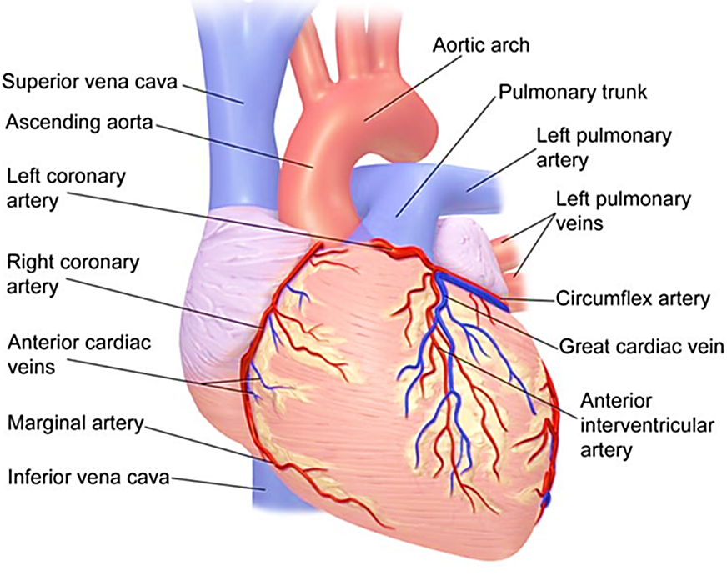
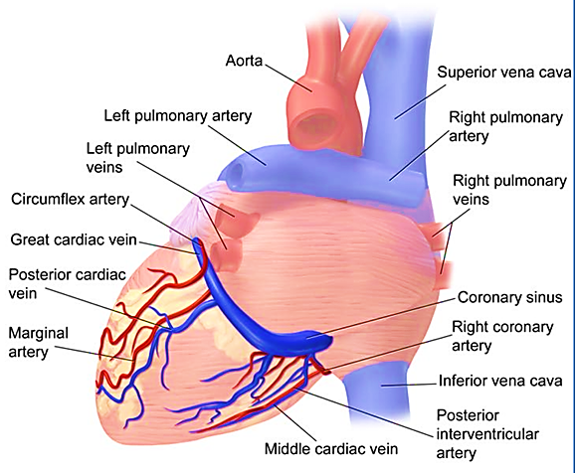
Review of coronary circulation:
Coronary Circulation (Anterior)
Coronary Circulation (Posterior)

Slide 4
Review of coronary circulation:
LAD → Apex, Anterior LV, Anterior 2/3 of IV-Septum
LCX → Lateral LV
RCA → Entire RV, Postero-Superior LV, Posterior 1/3 of IV-Septum
Degrees of Coronary Blockage:
< 70% Occlusion: Asymptomatic
70-75% Occlusion: Angina
90% Occlusion: Chronic IHD
Unstable Plaque: Unstable angina +/- Rupture → Acute MI
> 90% Occlusion: MI

Slide 5
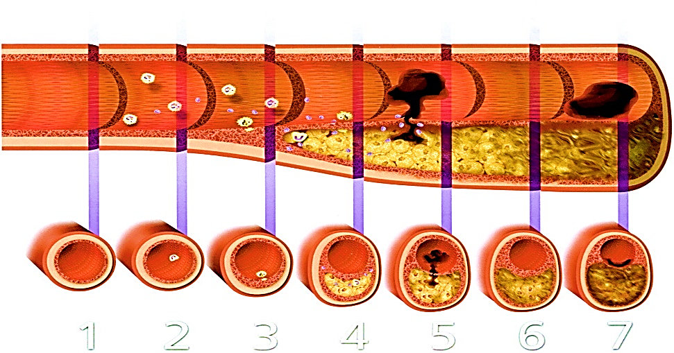
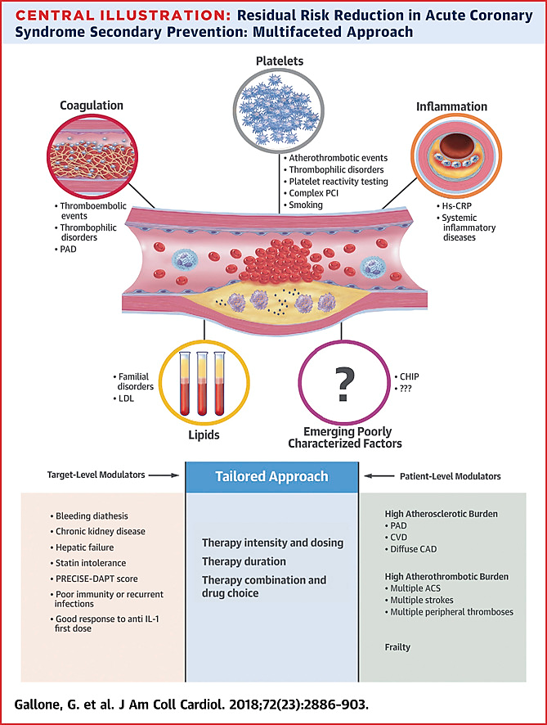
Progression of atherosclerosis:
Progressive inflammatory disorder of the arterial wall, characterized by focal lipid rich deposits of atheroma.
It remains clinically asymptomatic until:
Large enough to impair tissue perfusion .
Ulceration or disruption of the lesion result in thrombotic occlusion.
Clinical manifestation will depend upon site of the lesion and vulnerability of the organ supplied.

Slide 6
What Happens During
Myocardial Ischaemia:
Metabolic Changes (Aerobic → Anaerobic): ↑Lactate (Anaerobic Metabolism) & ↓pH.
Pain: Nociceptor (pain receptor) Activation → Angina Pain.
Global Autonomic Symptoms: Tachycardia, Sweating, Nausea.
Pulmonary Congestion: LV-Failure → Pulmonary Congestion → Shortness of Breath.
Ventricular Arrhythmias: SVT or VT or VF (due to Re-Entrant Focus & Altered Conduction Patterns).
Myocardial Damage: Initially ‘Subendocardial’ Ischaemia/Infarction (ST-Depression & T-Wave Inversion) → Progresses to ‘Transmural’-Ischaemia/Infarction (ST-Elevation & Pathological Q-Waves).

Slide 7
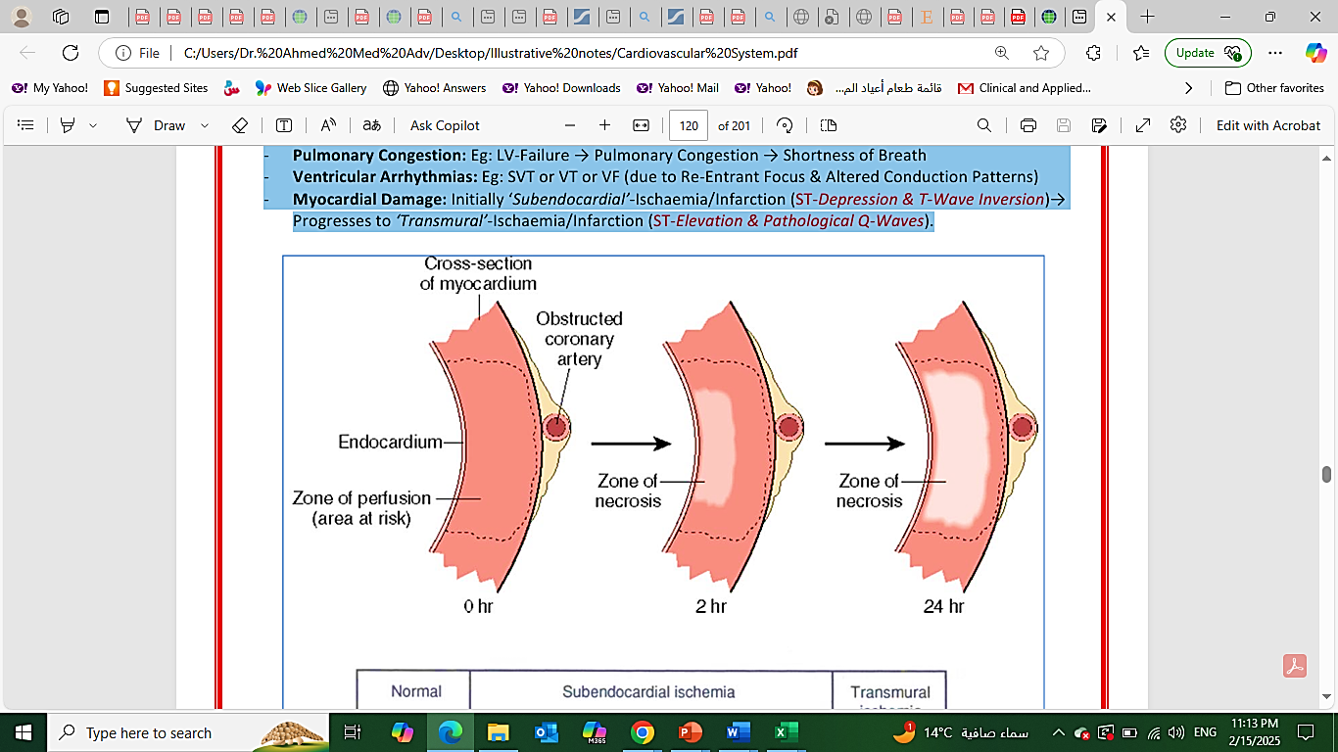
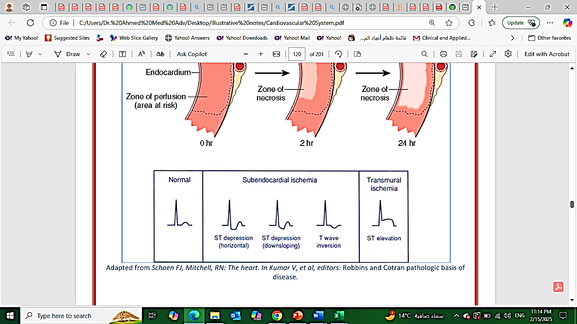
What Happens During
Myocardial Ischaemia:

Slide 8
RISK FACTORS AND MARKERS FOR CAD
Non-Modifiable Risk Factors
Age.
Male Sex.
Family history of premature coronary artery disease.
Modifiable Risk Factors
Hyperlipidemia.
Hypertension.
Diabetes Mellitus.
Metabolic syndrome.
Cigarette smoking.
Obesity.
Sedentary lifestyle.
Heavy alcohol intake.
Markers
Elevated Lipoprotein (a).
Hyperhomocysteinemia.
Elevated highly sensitive CRP.
Coronary artery calcification by MSCT

Slide 10
Angina Pectoris
Aetiology:
↓Myocardial Perfusion (relative to demand) due to Coronary Insufficiency.
Causes:
**Atherosclerosis / Vasospasm / Embolism / Ascending Aortic Dissection
Exacerbated by
(Vent-Hypertrophy, Tachycardia, Hypoxia, Coronary Arteritis (eg: in SLE))
Pathogenesis:
(= A Late Sign of Coronary Atheroma – Symptoms Imply >70% Occlusion!!)
(“Insufficient Coronary Perfusion Relative to Myocardial Demand”)

Slide 11
Angina Pectoris
Stable Angina:
Due to: Stable Atherosclerotic Coronary Obstruction (No Plaque Disruption)
Presentation: Chest Pain on Physical Exertion, which fades quickly with Rest (minutes)
Variant/Prinzmetal Angina:
Due to: Coronary Vasospasm (May not be Atheroma).
Presentation: Angina Unrelated to Activity (Ie: At Rest)
Unstable Angina (“Pre-Infarction Angina”):
Due to: Unstable Atherosclerotic Plaque (+/- Plaque Disruption & Thrombus).
Presentation: Prolonged Angina @ Rest (Either New-Onset/↑Severity/↑Frequency).
**Note: = Red Flag that MI may be Imminent
Silent Ischaemia:
Due to: Ischaemia masked by neuropathy (Eg: Diabetes/↓B12/etc.)
Presentation: Painless, but may have Nausea, Vomiting, Diaphoresis + Abnormal ECG

Slide 12
Angina Pectoris
Clinical Features of Angina:
Common Presentation:
**<15mins of Crushing, Central, Retrosternal Chest Pain → Radiating to Arms, Neck or jaw
(Stable: On exertion)
(Prinzmetal: Rest)
(Unstable: Worsening/Prolonged/@Rest)
+ Dyspnea (Pulmonary Congestion).
+ Fear of Impending death.
Signs:
↑Sympathetic Drive → Diaphoresis.
Hypotension → Cold/Clammy/Peripheral Shut-Down/Thready Pulse.
Pulmonary Congestion → Dyspnea, ↑JVP.

Slide 13
Angina Pectoris
Investigations:
(1st Line) Resting ECG:
During Attack: ST-Depression, T-wave Inversion (Normal between Attacks)
(Path-Q-Waves if Previous MI).
(2nd Line) Cardiac Stress Test + ECG: Suggests Severity of CAD – (Any ST Depression is a +Ve Result).
(3rd Line) Stress Echocardiography: Assess Ventricular Function.
(4th Line) MSCT: Coronary calcification as well as narrowed or blocked coronary arteries.
(5th Line) Coronary Angiography (Cath-Lab): Pre-Angioplasty to Map the Coronary Anatomy.
(6th Line) Myocardial Perfusion Scans (Nuclear Medicine)

Slide 14
Canadian Cardiovascular Society (CCS)
Angina Classification System
Clinical grading system based on degree of limitation of ordinary physical activity
Class I: No limitation.
Class II: Slight limitation.
Class III: Marked Limitation.
Class IV: Anginal occurs with any physical activity or at rest.

Slide 15
Alarming symptoms
Alarm Symptoms | If present consider serious causes | Other causes for this features
Chest pain radiating to both arms | MI UA(Unstable angina) | Pericarditis Cervical spine disorders
Sudden onset chest pain and acute dyspnea | PE MI Spontaneous Pneumothorax | Pleuritis Musculoskeletal chest pain
Chest pain & hemoptysis | PE Pneumonia | Tracheobronchitis
Chest pain with fever | Pneumonia Acute GI pathology | Pleuritis Tracheobronchitis. Pericarditis

Slide 16
Angina Pectoris
Management/Treatment:
Non-Pharmacological:(Prevention/Management of CV Risk Factors):
Smoking/Hypertension/Hyperlipidemia/Diabetes/Obesity/Etc.
Medical Therapy (Maintenance):
Anti-Anginal Therapy:
Nitrates (GTN): Coronary Vasodilation →↑Cardiac Perfusion
B-Blockers (Metoprolol): To ↓Workload of the Heart
Ca-Channel Blockers (Diltiazem/Verapamil): To ↓Afterload
Antiplatelet Therapy:
• Aspirin / Clopidogrel.
Lipid Lowering Therapy:
• Statin +/- Fibrates.

Slide 17
Angina Pectoris
Revascularisation (Definitive)
OPTIONAL:
PCI – (Per-Cutaneous Intervention)/Coronary Angioplasty:
• Balloon Dilation/Stenting of Coronary Arteries via Femoral Artery.
OR:
CABG (Coronary Artery Bypass Grafting):
• Harvested Vein (Saphenous/Wrist) → Bypasses the blockage.

Slide 18
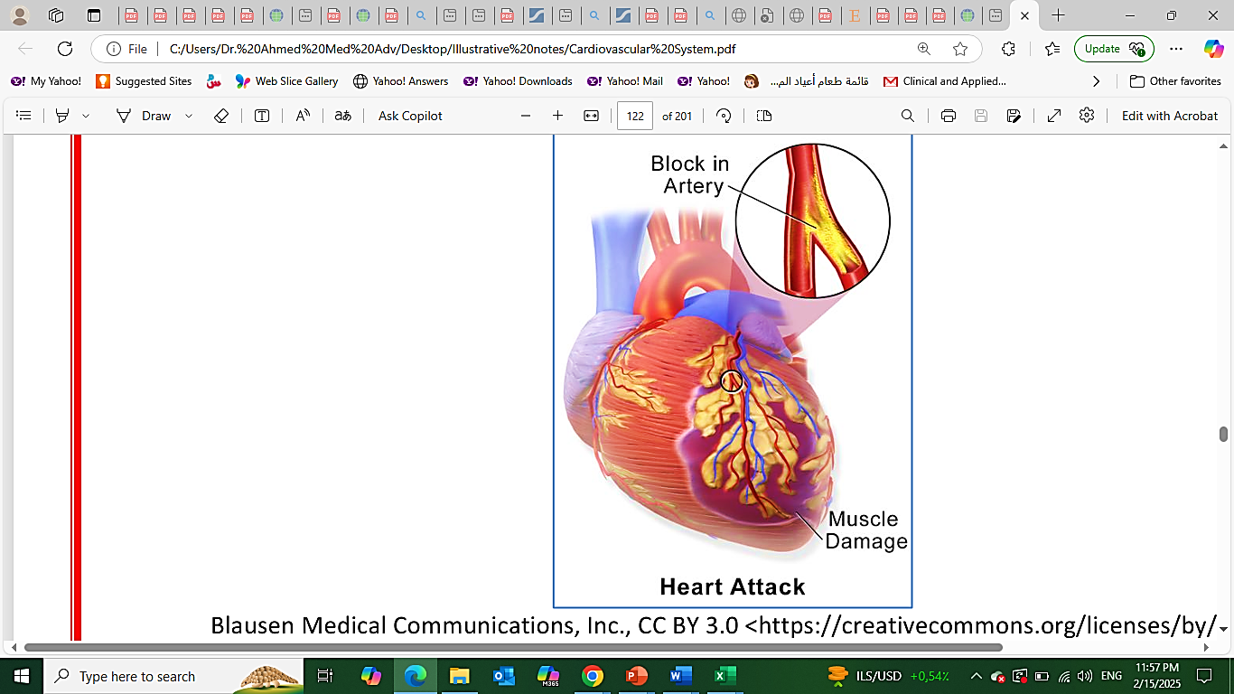
ACUTE CORONARY SYNDROMES
(STEMI/NSTEMI)
Aetiology:
Unstable Atheroma
Pathogenesis:
Unstable Atheroma → Rupture → Prolonged Ischaemia → Necrosis/Death of Myocardium.
(→ Sudden Death, Acute Systolic Dysfunction & Heart Failure, Vent. Rupture)
Progression of Ischaemic Necrosis & “ST-ELEVATION?”:
1- Initially “Subendocardial Necrosis” → NON-ST-ELEVATION MI:
• ST-Depression + T-Wave Inversion (As with Angina)
2- Then “Transmural Necrosis” → ST-ELEVATION MI:
• ST-Elevation + T-Wave Inversion + Pathological Q-Waves
§ Note: The Endocardium is spared due to O2/Nutrients of Ventricular Blood.

Slide 19
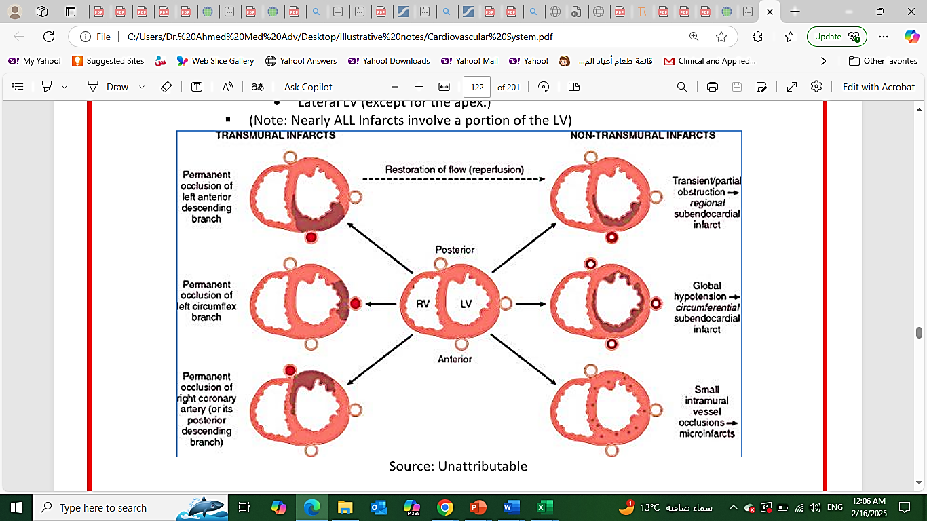
ACUTE CORONARY SYNDROMES
(STEMI/NSTEMI)
Most Common Coronary Obstruction & Locations of Ischaemia:
50% - LAD (left anterior descending artery) Obstruction:
• Anterior-LV + Apex + Ant.2/3 of IV-Septum
30% - RCA Obstruction:
• Posterior-LV + Posterior Septum + Free wall of RV.
20% - LCX (Left Circumflex) Obstruction:
• Lateral LV (except for the apex.)
Note:
Nearly ALL Infarcts involve a portion of the LV)

Slide 20
ACUTE CORONARY SYNDROMES
(STEMI/NSTEMI)
Clinical Features of NSTEMI/STEMI:
Common Presentation:
**>20mins Crushing, Central, Retrosternal Chest Pain → Radiating to Arms, Neck or Jaw.
• (Note: Some are “Silent” – eg: Diabetes, Post Cardiac Surgery, Elderly)
+Dyspnoea (Pulmonary Congestion)
+ Fear of Impending death
Signs:
↑Sympathetic Drive → Diaphoresis
Hypotension → Cold/Clammy/Peripheral Shut-Down/Thready Pulse
Pulmonary Congestion → Dyspnea/Tachypnoea/↑JVP
Signs of PVD

Slide 21
ACUTE CORONARY SYNDROMES
(STEMI/NSTEMI)
Investigations:
(1st Line):
Serial Resting 12Lead ECGs – (Every 15 Mins):
• ST-Changes and Diagnosing MI:
V1, V2, V3, V4 = Anterior MI.
II, III, AVF = Inferior Wall MI.
I, AVL, V5, V6 = Lateral.
3-Lead Cardiac Telemetry – (Screening for Arrhythmias)
Serial Troponin Levels (Cardiac Troponin-I/T, or CK-MB):
1st. On Presentation
2nd. @ 6hrs (↑Troponin = MI)
3rd. Within 24hrs
+ Bloods – (FBC, Serum Electrolytes, Glucose, Lipids)

Slide 22
ACUTE CORONARY SYNDROMES
(STEMI/NSTEMI)
Cardiac markers
A rise/ fall of serum markers
Typical time course for the detection of enzymes released after myocardial infarction.
AST: Aspartate aminotransferase.
CPK: creatine kinase.
cTnI: cardiac troponin I.
cTnT: cardiac troponin T.
LDH: lactate dehydrogenase

Slide 23
ACUTE CORONARY SYNDROMES
(STEMI/NSTEMI)
(2nd Line):
TTE/TOE “Transthoracic/Transesophageal Echo”:
• Assess LV-Function
• (+ Excludes DDXs: Aortic Dissection/Pericarditis/Pulmonary Embolism).
Myocardial Perfusion Scans (Nuclear Medicine):
• Location of Infarct

Slide 24
ACUTE CORONARY SYNDROMES
(STEMI/NSTEMI)
Management
(As with Angina PLUS MORPHINE, O2 & ANTICOAGULATION + DEFINITIVE Mx):
(Simplified: MONA = Morphine, Oxygen, Nitrates, Aspirin)
Medical Therapy (Maintenance):
Anti-Anginal Therapy:
Nitrates (GTN/Isosorbide Mononitrate) – Coronary Vasodilation →↑Cardiac Perfusion.
B-Blockers (Propranolol/Metoprolol) – To ↓HR & Contractility → ↓Cardiac Workload.
Ca-Channel Blockers (Nifedipine/Verapamil) – To ↓Afterload → ↓Cardiac Workload.
Antiplatelet Therapy:
(Aspirin / Clopidogrel)
Lipid-Lowering Therapy:
Statins +/- Fibrates
+Morphine: (Analgesia + Vasodilation)
+Oxygen: (To Maximize O2 @ Myocardium)
+Anticoagulation: (Heparin/LMWH or Warfarin) (Prevent Further Thrombogenesis).

Slide 25
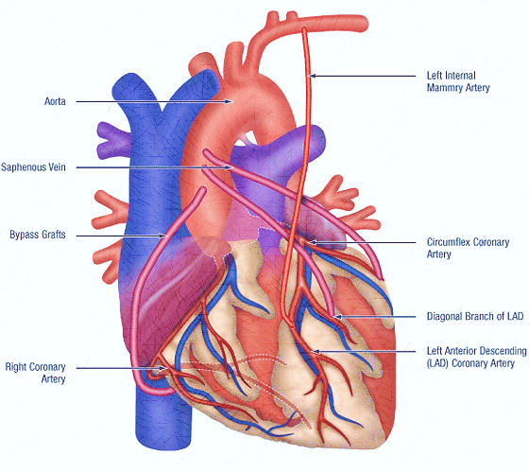
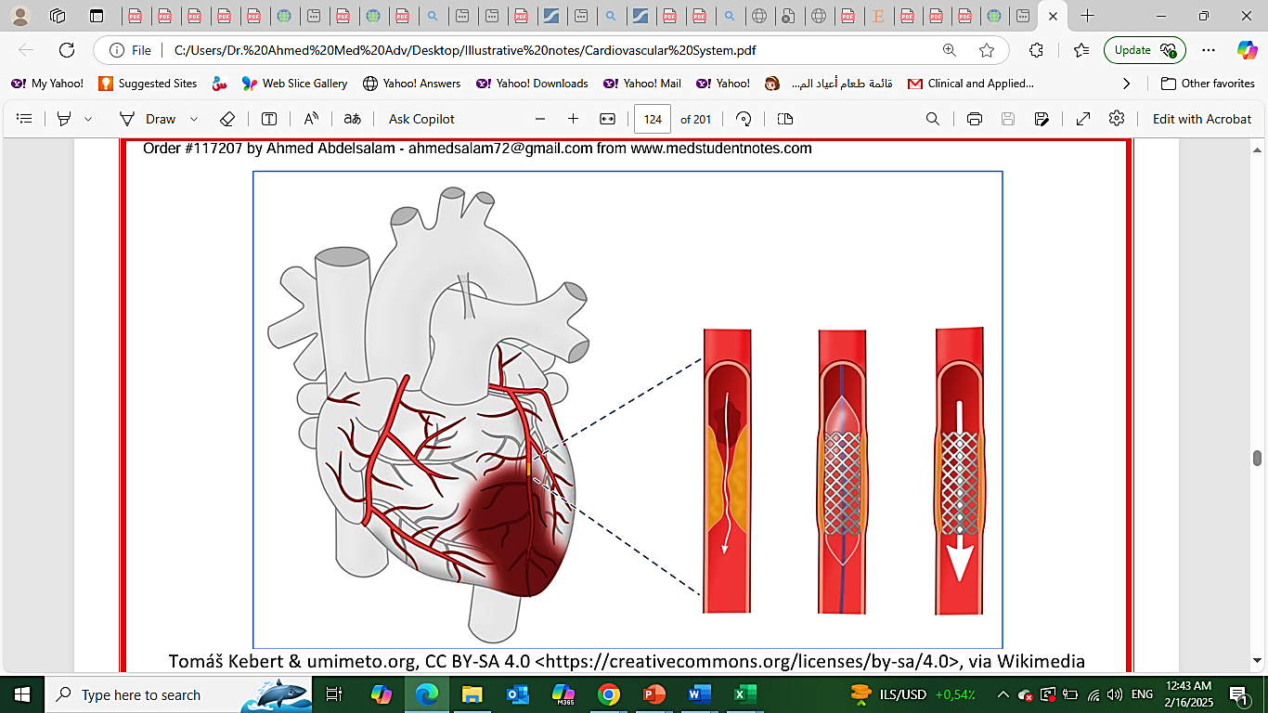
ACUTE CORONARY SYNDROMES
(STEMI/NSTEMI)
2- STAT Revascularisation (Definitive) – WITHIN 4 HRS:
** PCI – (Per-Cutaneous Coronary Intervention) - Coronary Angioplasty:
• Balloon Dilation/Stenting of Coronary Arteries
OR... Thrombolysis/Fibrinolysis (With TPA – “Tissue Plasminogen Activator”/“Alteplase”):
• Contraindicated in: Hx of CVA, Stroke <3mths, Aortic Dissection, Active Bleeding.
** CABG:

Slide 26
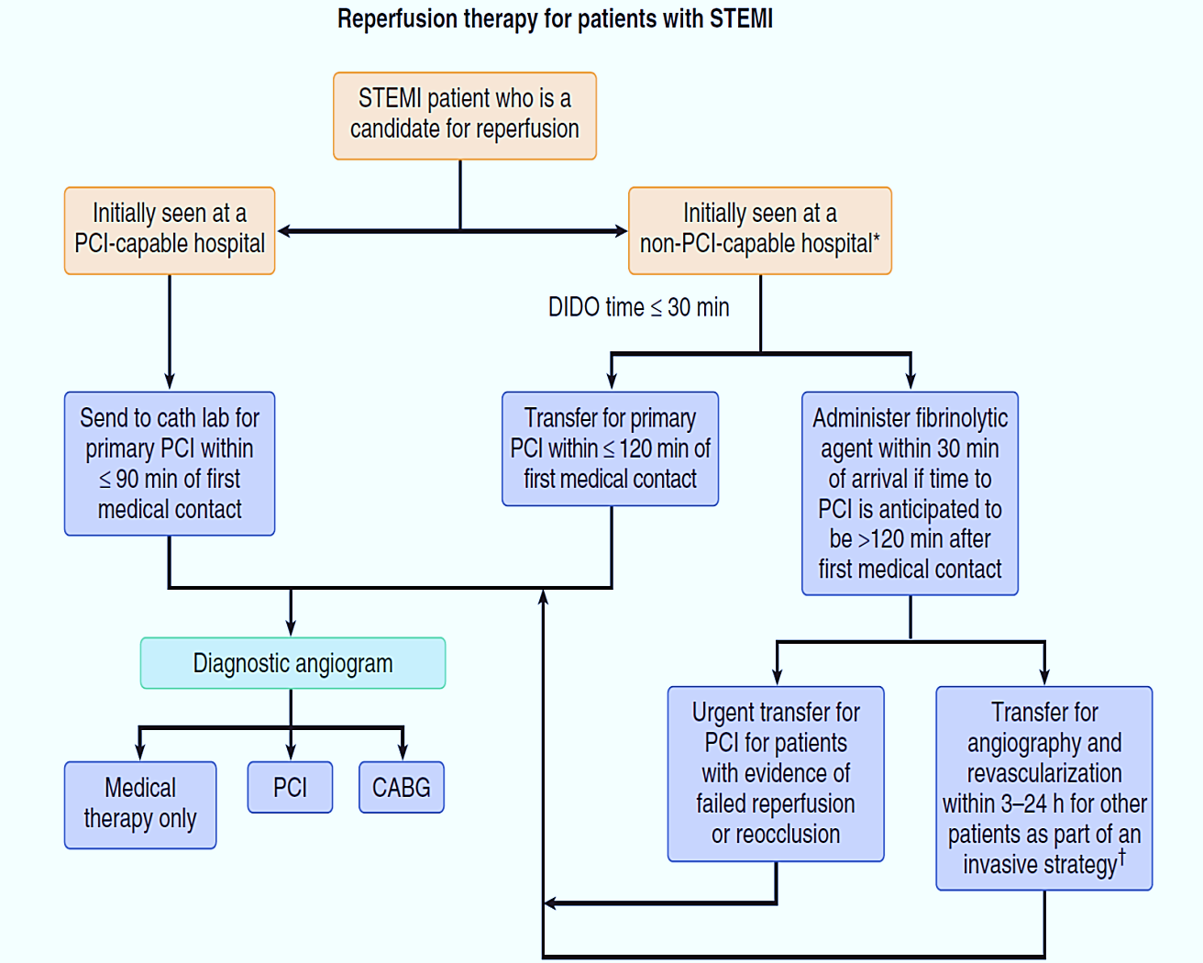
Reperfusion therapy for patients
With STEMI

Slide 27
ACUTE CORONARY SYNDROMES
(STEMI/NSTEMI)
Complications:
Acute Complications:
LV-Failure: → Acute Pulmonary Oedema, Shock (70% Mortality)
Lethal Arrhythmias: → VT, VF
Weakening of Necrotic Myocardium → Myocardial Rupture: Tamponade / Acute VSD
Stasis → Mural Thrombosis → Embolization → Stroke
Chronic Complications:
Ventricular Aneurysm.
Papillary Muscle Rupture – Mitral regurgitation.
Ischemic heart failure.

Slide 28
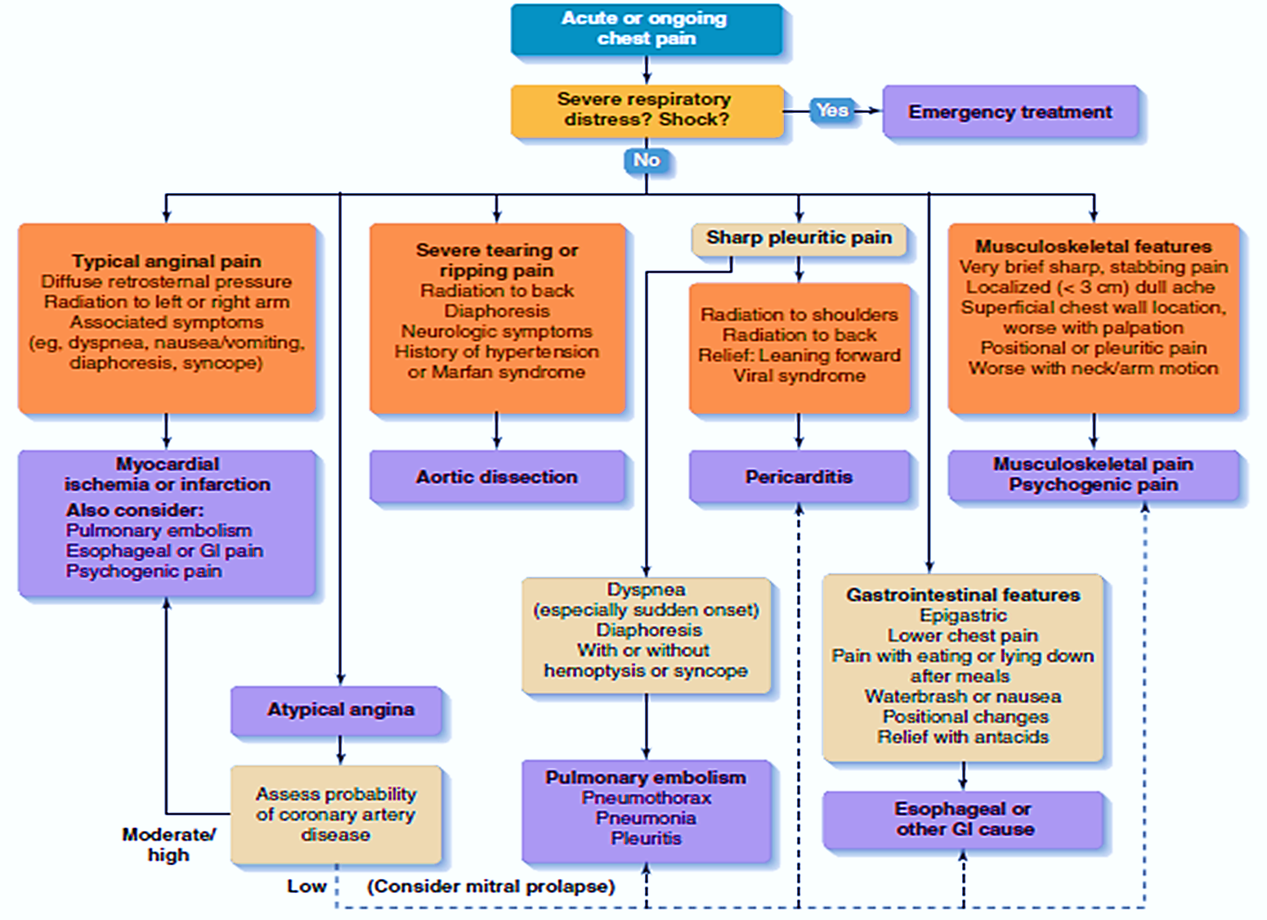
Acute or Ongoing Chest Pain
Evaluation

Slide 29
Cardiac Rehabilitation
A coordinated multifaceted interventions designed to optimize a cardiac patient's physical, psychological, and social functioning in addition to stabilizing, slowing, or even reversing the progression of the underlying atherosclerotic process, thereby reducing morbidity and mortality.
It includes 4 phases starting with
Conditioning from acute event or post CABG to make the patient functionally independent, and to prepare for discharge from hospital.
Nutritional counseling , and
Establish secondary prevention targets.
It includes also early ambulation and gradual exercise programs under supervision as well as psychological management.

Slide 30
Prognosis Following STEMI
5-10% of hospitalized patients will die
Infarct size/severity
Age
Comorbid conditions
Development of heart failure or hypotension
Post-discharge mortality rates
6-8% within first year, half of these within first 3 months 4% per year following first year
LV dysfunction
Residual myocardial ischemia
Ventricular arrhythmias
History of prior MI

Slide 31
Take Home Message
All patients with IHD should have good assessment by detailed history, physical examination and risk factor identification for proper and early management.
Identify & differentiate between typical and atypical presentation of IHD is mandatory.
Stress testing is crucial in diagnostic workup of patients suspecting to have IHD.
Early diagnosis and management of acute coronary syndrome is crucial and it affect the functional status of patients post insult.

Slide 32
Quiz
65 years old man retired, was presented to emergency department by 6 hours history of retrosternal crushing chest pain radiating to jaw , he had an episode of vomiting , he has history of diabetes and hypertension for 10 years but not well compliant to the medication, he is smoker for the last 30 years 10-15 cig per day, and stopped 2 years ago.
He has family history of DM and Dyslipidemia.
On examination:
pulse :115 per minute regular
BP:160/105 lying
RR: 26 /min

Slide 33
Quiz
Temperature: normal
Systemic exam : the patient looks sweaty.
there is xanthelasma
There is Arcus senelis
No pallor, or jaundice or cyanosis.
Tobacco staining.
JVP not elevated .
No carotid bruit.
Cardiac exam :
Normally placed apex, heaving in character.
S2 is accentuated over the aortic area.

Slide 34
Quiz
Lung examination showed no abnormality
No organomegaly
No pedal edema.
Review of other systems showed no abnormality.
What is your differential diagnosis?
How to diagnose ?
How to manage , immediate and late management ?

Slide 35
Thank You

